Slide 1
Archives
ENGL 1102 Summer 2017
Agent of the Multiverse, Part II
Instructor: Josh Hussey

Slide 2
Assignment Sheet Version 02

Slide 3
DataSet Types & Possibilities
Text
Project Gutenberg, Internet Archive, magazines
Images
Book covers, journal covers, journal art, movies
Scale of text or images
Large corpus or small
Use defined collections (ex. Weird Tales 1970-1980)

Slide 4
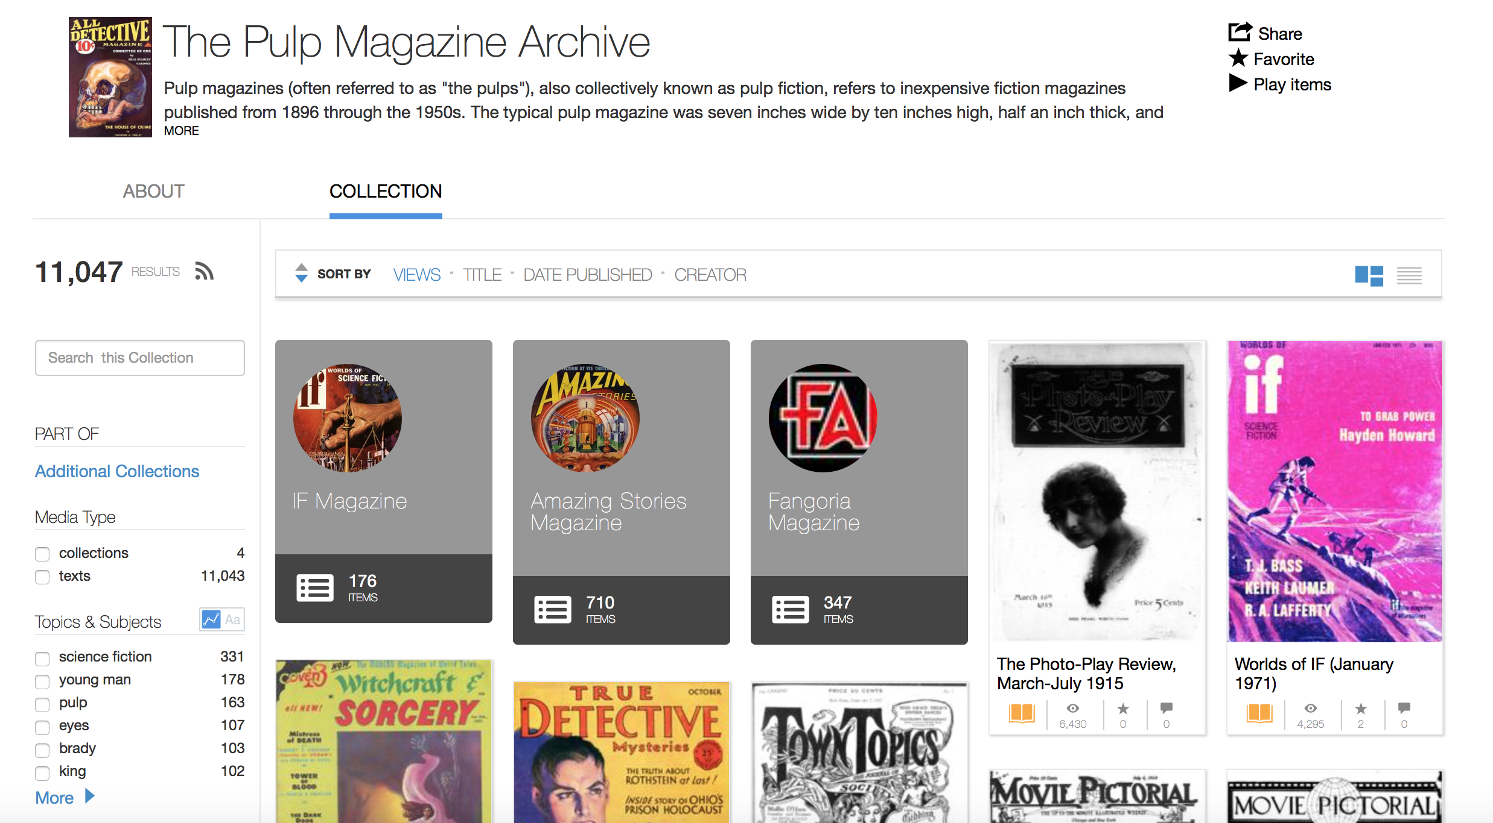
Internet Archive

Slide 5
Gt Archives sf Portal http://www.library.gatech.edu/scifi/

Slide 6
Analysis
“humanness” of data inquiry = interpretation, explanation
Purpose: divide into distinct groups that naturally organize
Text analysis
KWIC, top features, concordance
Topic models

Slide 7
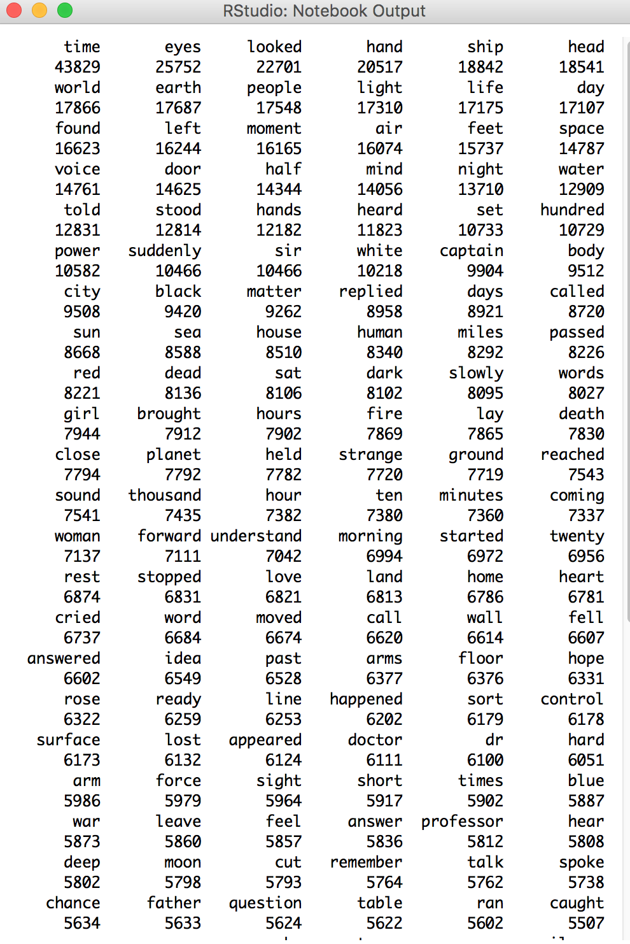
Project Gutenberg sf analysis topic models and Top Features

